Slide 1

Department of Information Technology
NBA Accredited
A.P. Shah Institute of Technology
G.B.Road, Kasarvadavli, Thane (W), Mumbai-400615
UNIVERSITY OF MUMBAI
Academic Year 2024-2025

Slide 2

A Project Presentation on
EduFlex: ML driven cross-platform application for displaying and acknowledging students achievement.
Submitted in partial fulfillment of the degree of
Bachelor of Engineering(Sem-8)
in
INFORMATION TECHNOLOGY
Sankalp Gunjal(21104087)
Sumit Mesta(21104069)
Soham Dalvi(21104010)
Siddharth Devare(21104136)
Under the Guidance of
Ms. Sonal Jain

Slide 3

1.Project Conception and Initiation

Slide 4

1.1 Abstract
Eduflex is a web-based platform that evaluates academic, co-curricular, and personal achievements using AI and ML.
Built with Python, Flask, and MongoDB for scalability and automation.
Integrates Credly for automated certification verification.
Uses Generative AI to let students create personalized courses.

Slide 5

1.2 Objectives
To design and develop a web framework/cross-platform app offering a holistic view of student achievements.
To help students generate personalized courses, using ML to identify gaps and AI to create content.
To create a data visualization platform providing clear, actionable insights through interactive displays.
To build a scalable cloud infrastructure for real-time data processing and reliable app availability.

Slide 6
1.3 Literature Review
Sr No | Paper Title | Author | Year | Key Findings | Key Innovations
1. | Generative AI for Customizable Learning Experiences | Ivica Pesovski et al. | 2024 | Generative AI enables adaptive learning environments by assessing progress and generating quizzes. | Generative Adversarial Networks(GANs), Adaptive Algorithms
2. | AI-Powered Personalized Learning Journeys: Revolutionizing Information Management for College Students | Yang M. et al. | 2023 | AI-powered platforms create detailed student profiles, enabling tailored recommendations | NLP, ML Algorithms

Slide 7
1.4 Problem Definition
Problem Identified:
Traditional systems focus on grades, overlooking co-curricular activities, soft skills, and personal achievements, limiting a well-rounded evaluation.
Current education systems lack personalized learning, offering no tailored resources based on individual strengths and areas for improvement.
Solution Proposed:
EduFlex provides a comprehensive assessment by recognizing academic, co-curricular, and soft skills achievements through advanced technology.
EduFlex enables students to create personalized courses tailored to their goals and needs using Generative AI.
\

Slide 8
1.5 Scope
Can create student profiles by collecting academic and extracurricular achievements.
Can use AI for personalized course creation based on areas for improvement.
Can offer real-time analytics for educators to track student progress and enable timely support.
Can incorporate gamification to motivate students with points or badges for completing tasks.

Slide 9
1.6 Technology stack
1. FRONTEND (GUI):
HTML
CSS
JAVASCRIPT
2. BACKEND:
Node.js
Express.js
MongoDB
Python
External Source (Credly)

Slide 10
2. Project Design

Slide 11
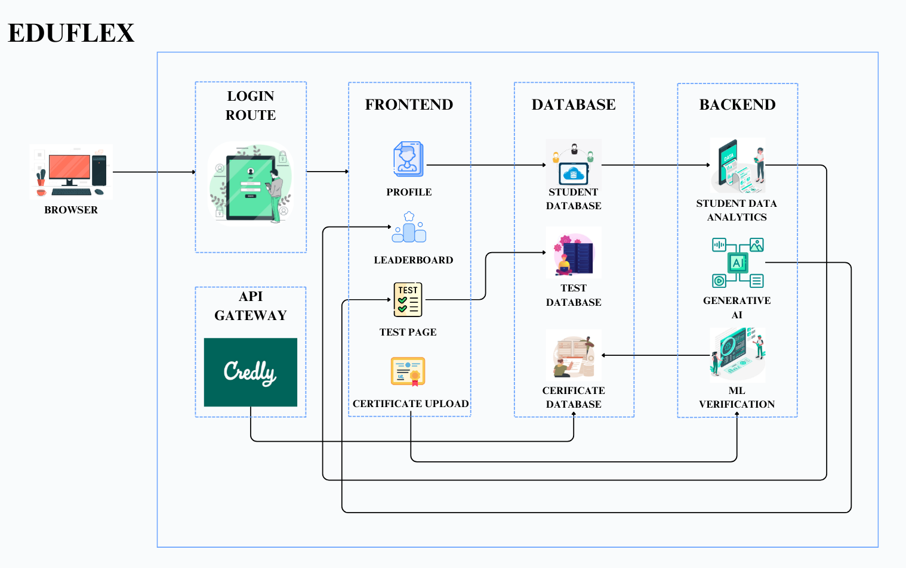
2.1 Proposed System

Slide 12
2.2 Design(Flow Of Modules)
User Interaction & Data Input
Students log in → Authenticate using credentials.
Upload certification documents → System receives and stores uploaded files.
Processing & Validation
ML Verification System → Analyzes uploaded certificates for authenticity and detects tampering.
Generative AI Module → Evaluates student profiles and recommends personalized courses.
Data Storage & Updates
EduFlex Database → Stores verified certificates, test results, and engagement metrics securely.
Gamification & Recognition
Leaderboards & Badges → Updated in real-time based on student activity.
Performance-based rewards → Assigned dynamically as students engage with the platform.
Real-Time Feedback & Insights
Educators receive reports → AI-driven insights help track student progress.
Identifying learning gaps → Data highlights areas where students need additional support.
j

Slide 13
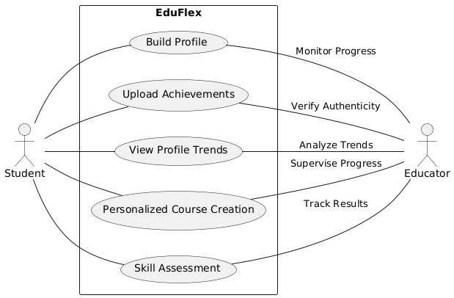
2.3 Use Case

Slide 14
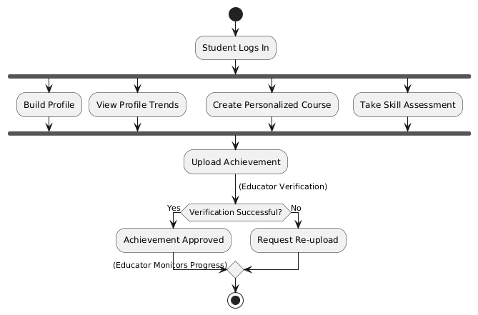
2.4 Activity diagram

Slide 15
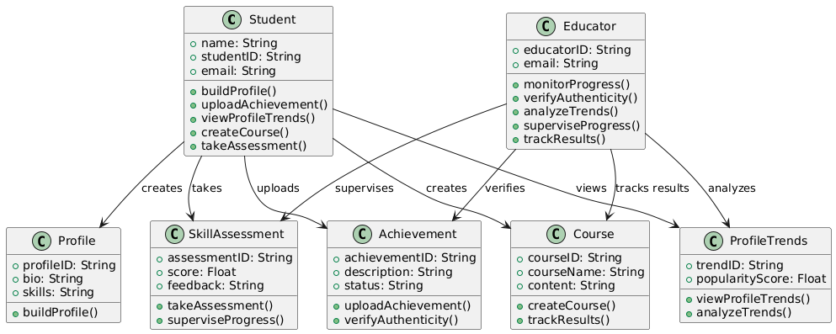
2.5 Class Diagram

Slide 16
3. Implementation

Slide 17
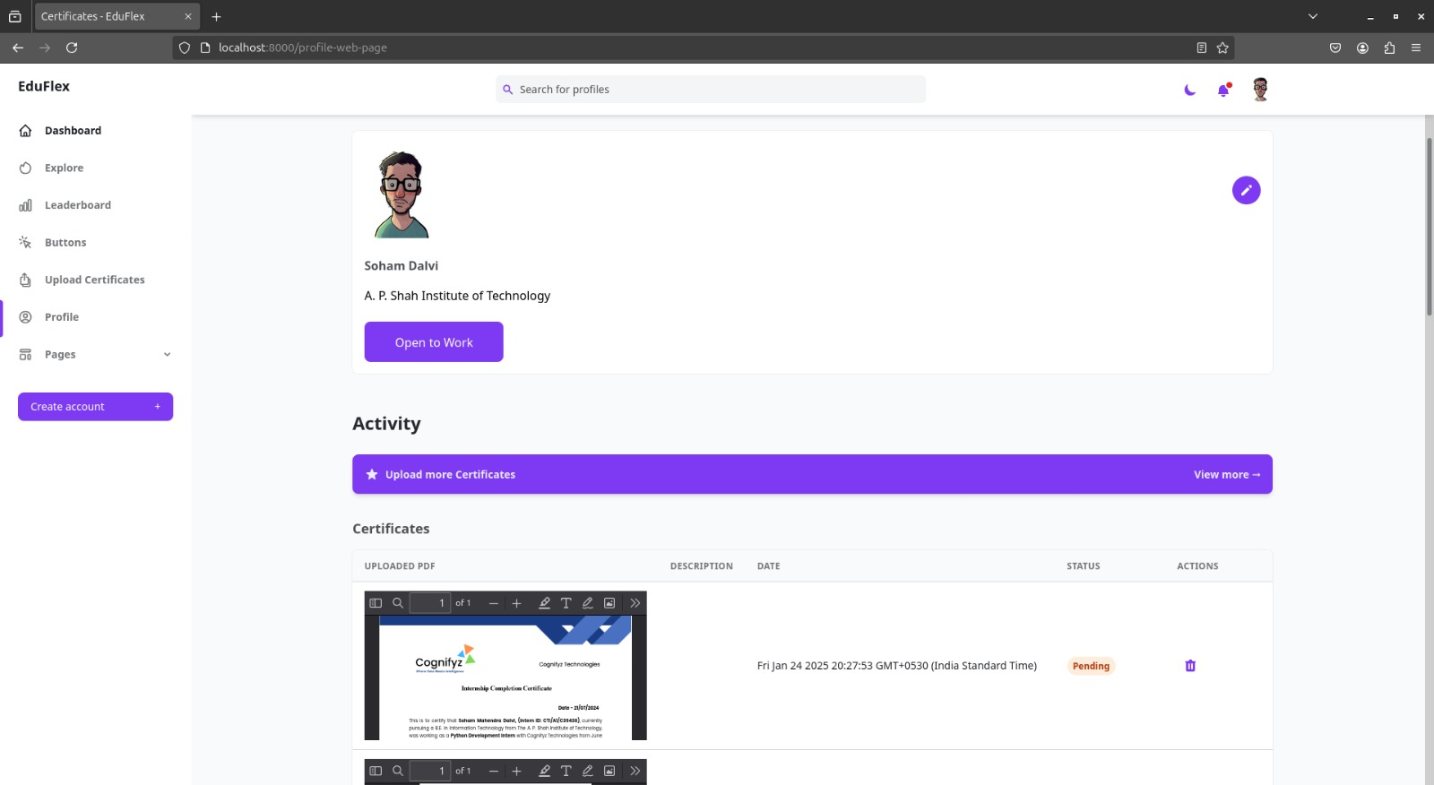
Fig 3.1: User Profile

Slide 18
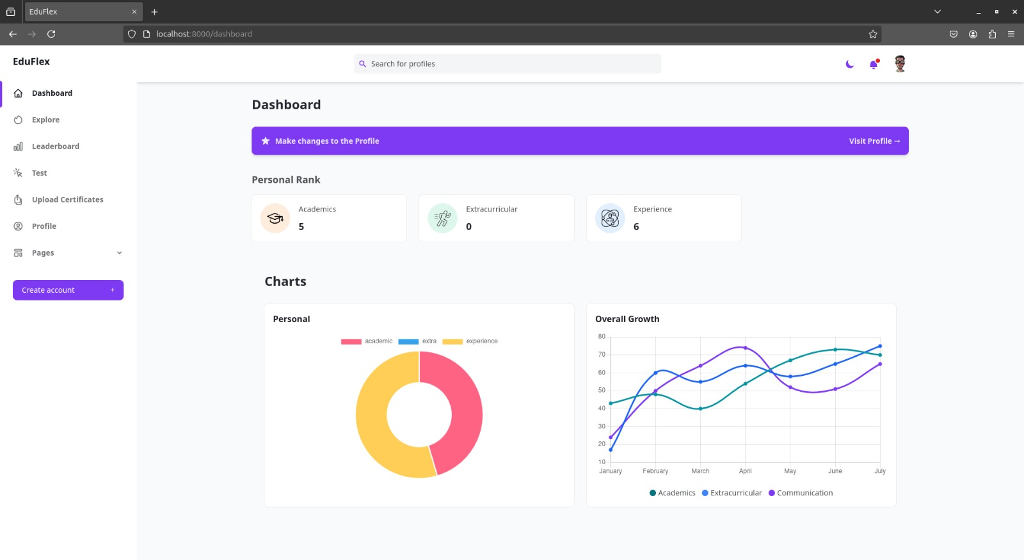
Fig 3.2: Dashboard

Slide 19
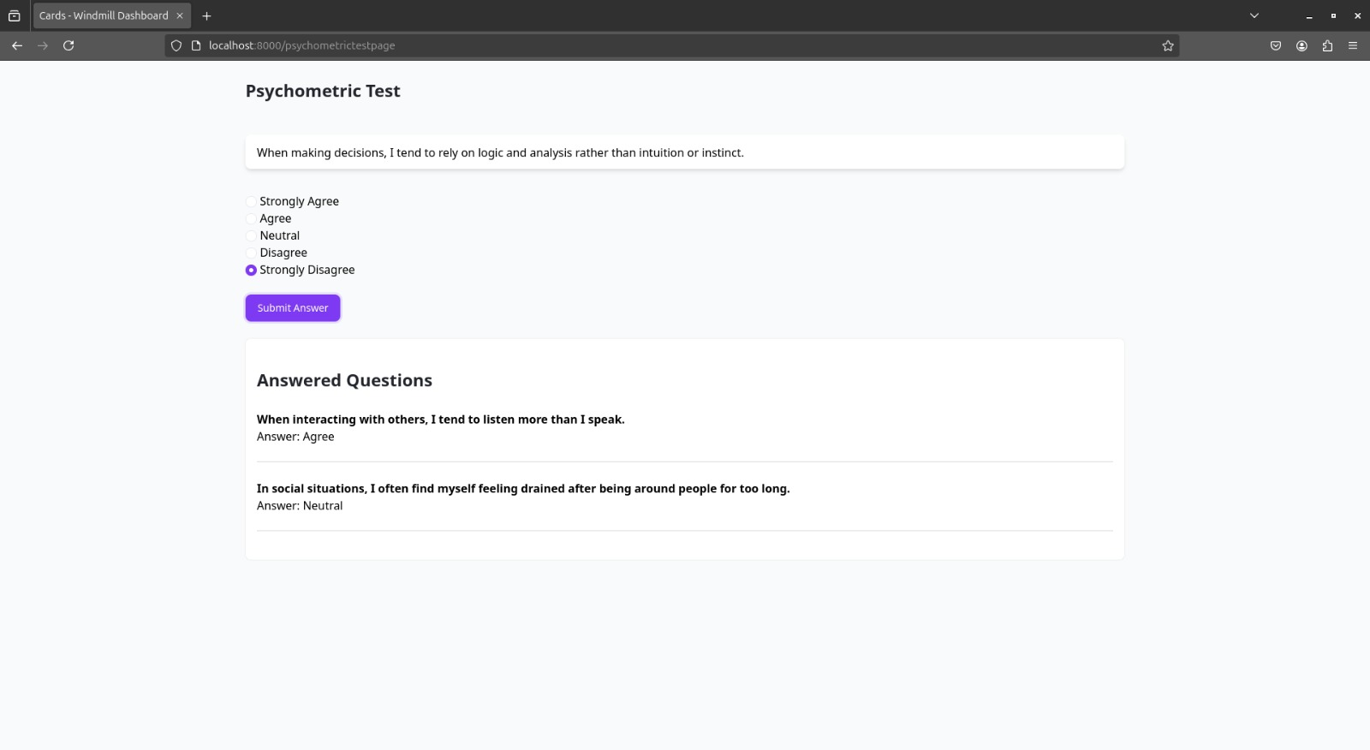
Fig 3.1: Test Page

Slide 20
5. Result

Slide 21
High Accuracy in Certificate Verification
92% accuracy achieved using Random Forest & CNN models.
Effectively detects tampered certificates by analyzing various parameters
Minimal false positives and negatives due to optimized dropout layers in CNN.
Efficient Mentor-Student Collaboration
Simplifies group creation and progress tracking.
Handles large datasets efficiently, ensuring smooth user experience.
Real-Time Dashboards & Automation
Transparent validation process with real-time updates.
Automated fetching of Credly badges enhances student profile management.

Slide 22
6. Conclusion and Future
Scope

Slide 23
Unified Evaluation System
Integrates academic, co-curricular, and extracurricular achievements for holistic assessment.
Advanced ML & Automation
Provides certificate validation, personalized psychometric testing, and real-time feedback.
Ensures a comprehensive and accurate assessment process.
Overcoming Traditional Limitations
Addresses biases and inefficiencies in conventional assessment methods.
Delivers a scalable and reliable solution for educational evaluation.
Future Potential & Impact
AI-Driven Personalized Assessment.
Mental Well-Being Assessment Integration.
Redeemable Rewards(Shop).

Slide 24
References
Pesovski, I., Santos, R., Henriques, R., Trajkovik, V.: Generative ai for customizable learning experiences. Sustainability 16(7), 3034 (2024).
Yang, M., Weng, F.: Ai-powered personalized learning journeys: Revolutionizing information management for college students in online platforms. Journal of Information Systems Engineering and Management 8(1), 23196 (2023).
Owoseni, A., Kolade, O., Egbetokun, A.: Enhancing personalised learning and student engagement using generative ai. In: Generative AI in Higher Education: Innovation Strategies for Teaching and Learning, pp. 123–150.Springer, (2024).

Slide 25
Paper Publication

Slide 26
Thank You

